Slide 1

6th Grade Math
Unit 1, Lesson 6 Finding the Perimeter and Area of Rectangles Volume 1, pg. 31

Slide 2


Benchmark
MA.5.GR.2.1
Find the perimeter and area of a rectangle with fractional or decimal side lengths using visual models and formulas.
volume 1, pg. 31

Slide 3
Integrated Mathematical Thinking and Reasoning Standards
MA.K12.MTR.1.1 Actively participate in effortful learning both individually and collectively.
MA.K12.MTR.2.1 Demonstrate understanding by representing problems in multiple ways.
MA.K12.MTR.4.1 Engage in discussions that reflect on the mathematical thinking of self and others.
MA.K12.MTR.5.1 Use patterns and structure to help understand and connect mathematical concepts.
MA.K12.MTR.7.1 Apply mathematics to real-world contexts.
volume 1, pg. 31

Slide 4

Learning Targets
I can find the perimeter and area of a rectangle with fractional side lengths.
I can find the perimeter and area of a rectangle with decimal side lengths.
volume 1, pg. 31

Slide 5

Warm-Up
volume 1, pg. 31

Slide 6
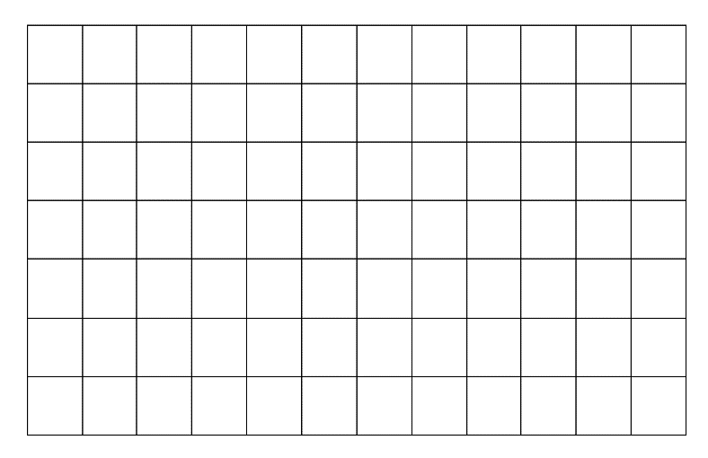

1.6.1 Warm-Up: 24 Lines
Use only $24$ of the gridlines to draw a rectangle.
How many different rectangles do you think can be drawn using only $24$ of the gridlines?
volume 1, pg. 31

Slide 7

Guided Instruction
volume 1, pg. 32

Slide 8
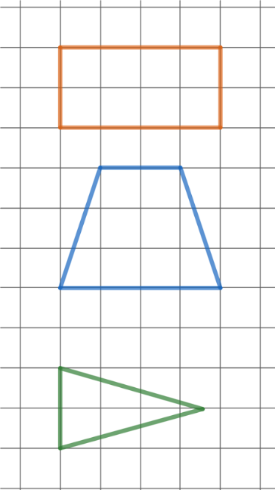
1.6.2 Guided Instruction: Finding Perimeter and Area
Perimeter is the distance around a
polygon.
One way to find the perimeter is to count the gridlines of the unit squares around the border.
What is the perimeter of the
rectangle?
Discuss with your partner why the strategy of counting gridlines to find the perimeter of the trapezoid or triangle cannot be used.
volume 1, pg. 32

Slide 9

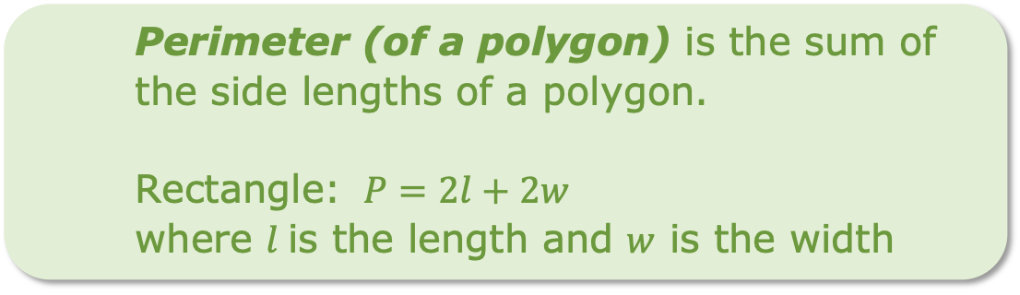
To find the perimeter of a polygon, the lengths of all the sides.
Some polygons have a formula that can be used to find the perimeter. Different figures have different formulas for perimeter.
add
subtract
multiply
divide
Perimeter (of a polygon) is the sum of the side lengths of a polygon.
Rectangle: $P=2l+2w$
where $l$is the length and $w$ is the width
volume 1, pg. 32

Slide 10
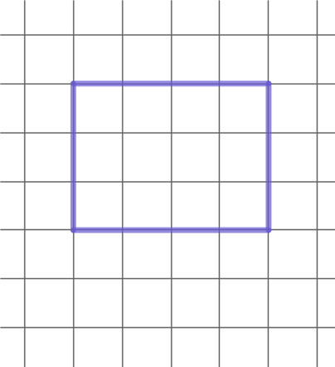

Consider the following rectangle below.
Use the rectangle to discuss with your partner why the formula shows that both the length and the width are multiplied by $2$.
volume 1, pg. 32

Slide 11
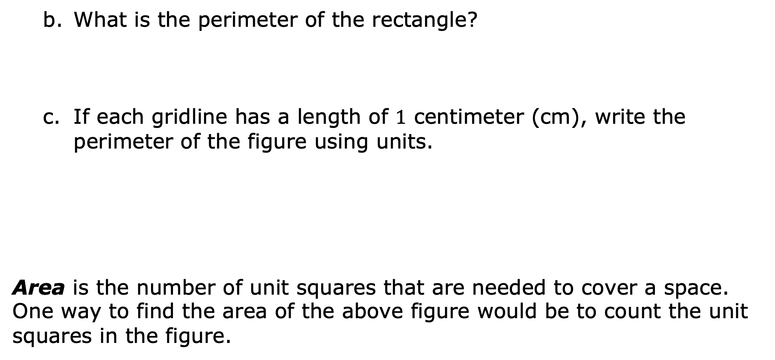
What is the perimeter of the rectangle?
If each gridline has a length of $1$ centimeter (cm), write the perimeter of the figure using units.
Area is the number of unit squares that are needed to cover a space. One way to find the area of the above figure would be to count the unit squares in the figure.
volume 1, pg. 32

Slide 12
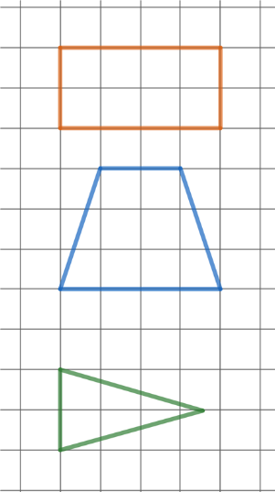
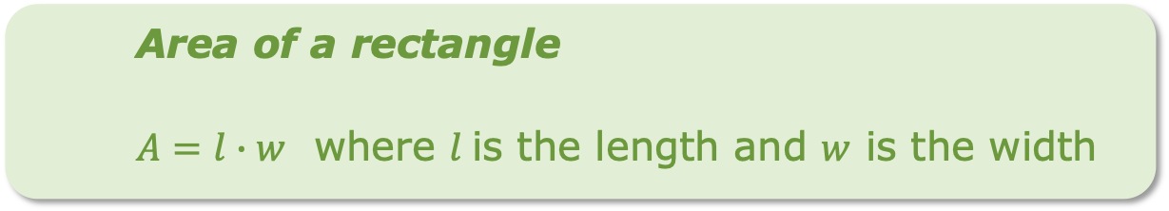
Discuss with your partner why counting
unit squares to find the area of the
trapezoid or triangle would be difficult.
Some polygons have a formula that can be used to find the area. Other kinds of figures have different formulas for area.
Area of a rectangle
$A=l∙w$ where $l$is the length and $w$ is the width
volume 1, pg. 33

Slide 13
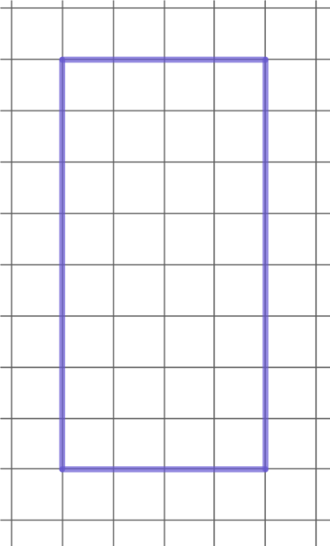
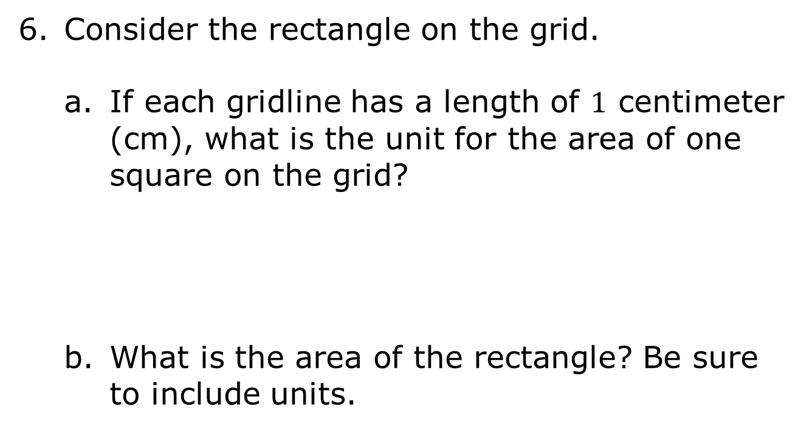
Consider the rectangle on the grid.
If each gridline has a length of $1$ centimeter (cm), what is the unit for the area of one square on the grid?
What is the area of the rectangle? Be sure to include units.
volume 1, pg. 33

Slide 14
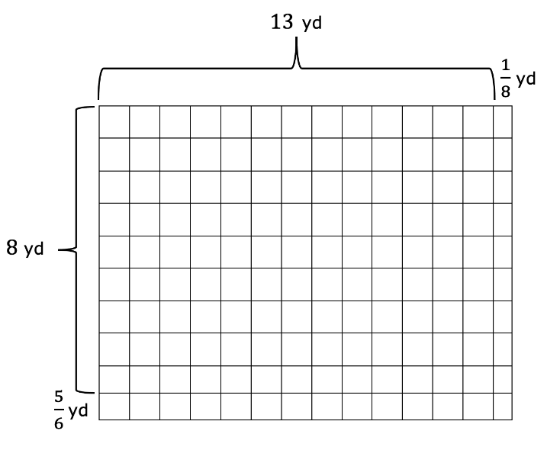
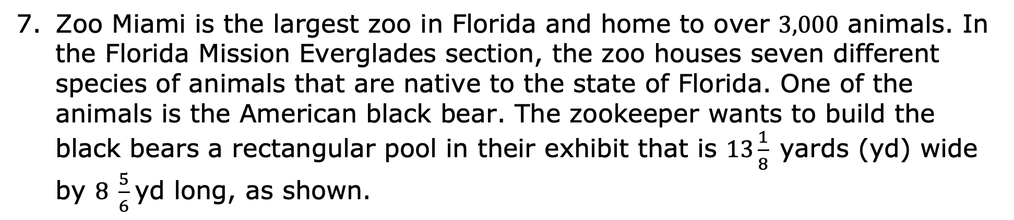
Zoo Miami is the largest zoo in Florida and home to over $3,000$ animals. In the Florida Mission Everglades section, the zoo houses seven different species of animals that are native to the state of Florida. One of the animals is the American black bear. The zookeeper wants to build the black bears a rectangular pool in their exhibit that is $13\frac{1}{8}$yards (yd) wide by $8 \frac{5}{6}$yd long, as shown.
volume 1, pg. 33

Slide 15
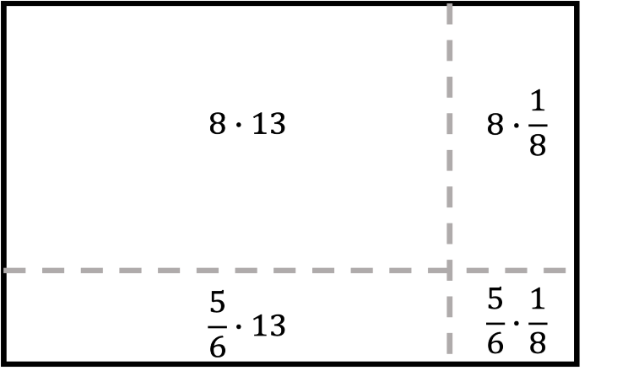
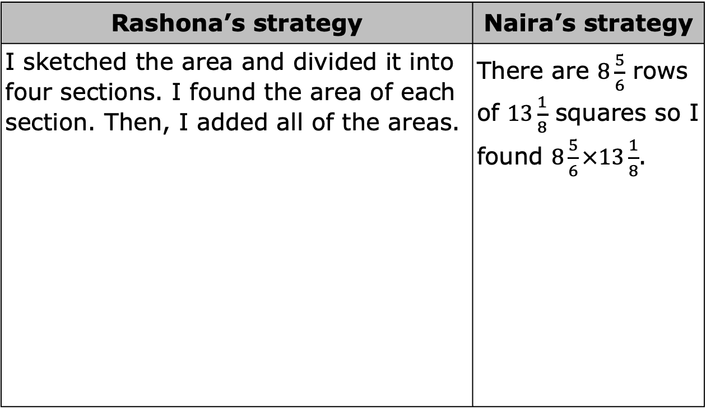
The table shows the strategies of two different students for finding the area of the pool for the American black bears.
Rashona’s strategy | Naira’s strategy
I sketched the area and divided it into four sections. I found the area of each section. Then, I added all of the areas. | There are $8\frac{5}{6}$ rows of $13\frac{1}{8}$ squares so I found $8\frac{5}{6}×13\frac{1}{8}$.
volume 1, pg. 34

Slide 16
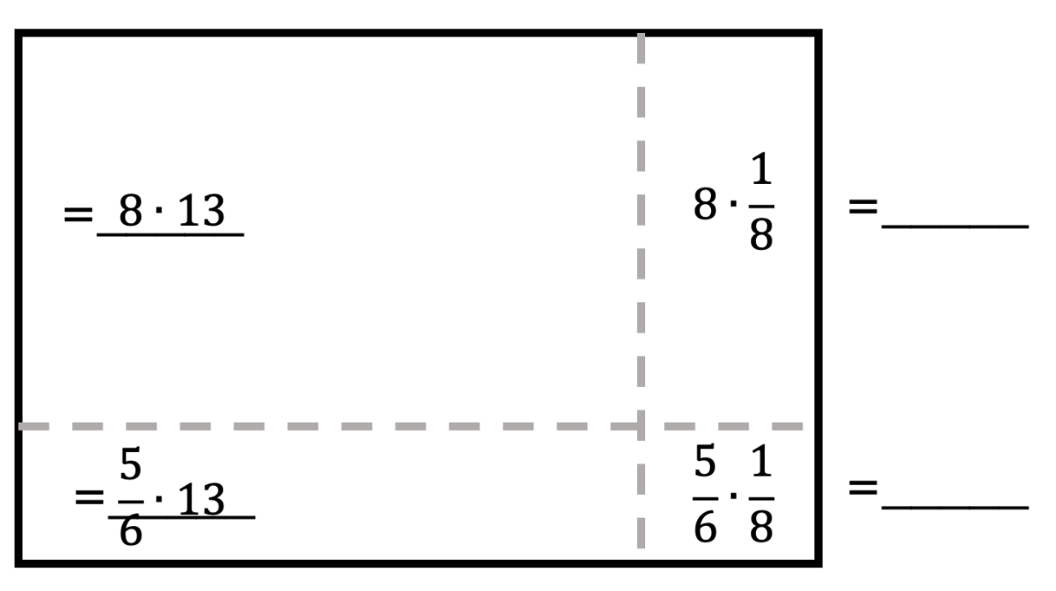
Use Rashona’s strategy to find the area of the pool for the American black bears.
Area of the pool = ______
volume 1, pg. 34

Slide 17
Use Naira’s strategy to find the area of the pool for the American black bears.
What are the units for the area of the pool?
How much fencing is needed to enclose the pool area?
What are the units for the amount of fencing for the pool?
volume 1, pg. 34

Slide 18
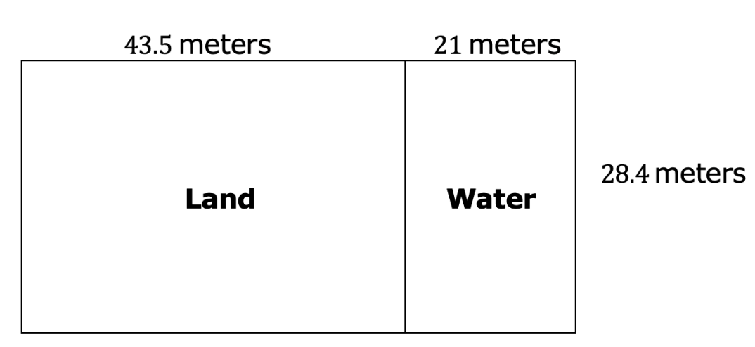
Discuss with your partner the difference between finding the perimeter of a rectangle and finding the area of a rectangle. Write down a strategy that you can use to remember the difference.
The American alligator is also featured in the Florida Mission Everglades area. A diagram of the alligator enclosure is shown.
volume 1, pg. 34

Slide 19
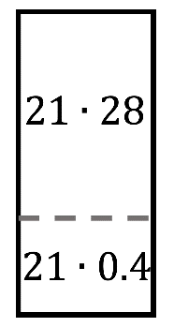
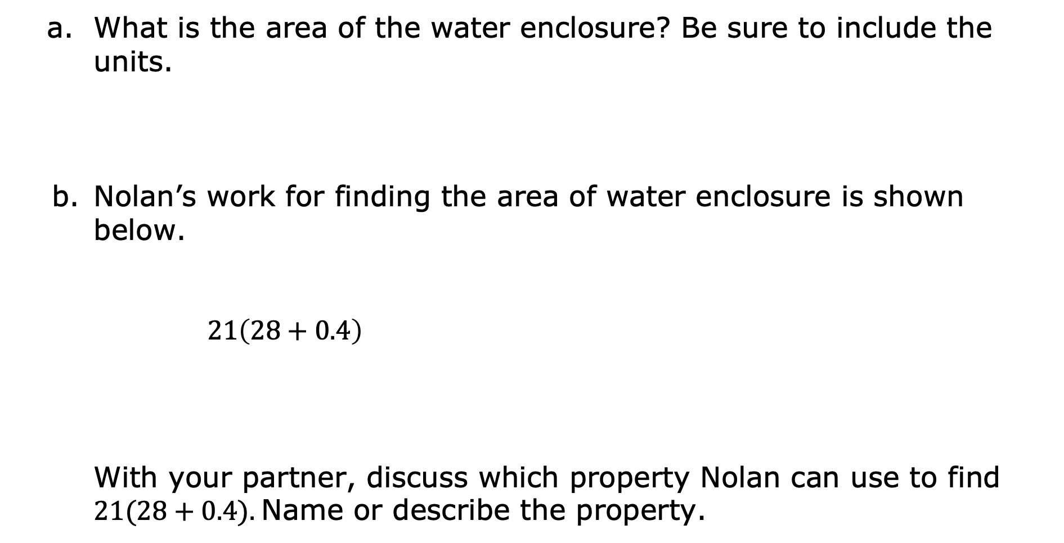
What is the area of the water enclosure? Be sure to include the units.
Nolan’s work for finding the area of water enclosure is shown below.
$21\left(28+0.4\right)$
With your partner, discuss which property Nolan can use to find $21(28+0.4).$Name or describe the property.
volume 1, pg. 35

Slide 20
What is the area of the alligator enclosure? Be sure to include the units.
Work with your partner to determine the total amount of fencing needed for the alligator enclosure. Show your work or strategies you used.
volume 1, pg. 35

Slide 21

Collaboration
volume 1, pg. 36

Slide 22

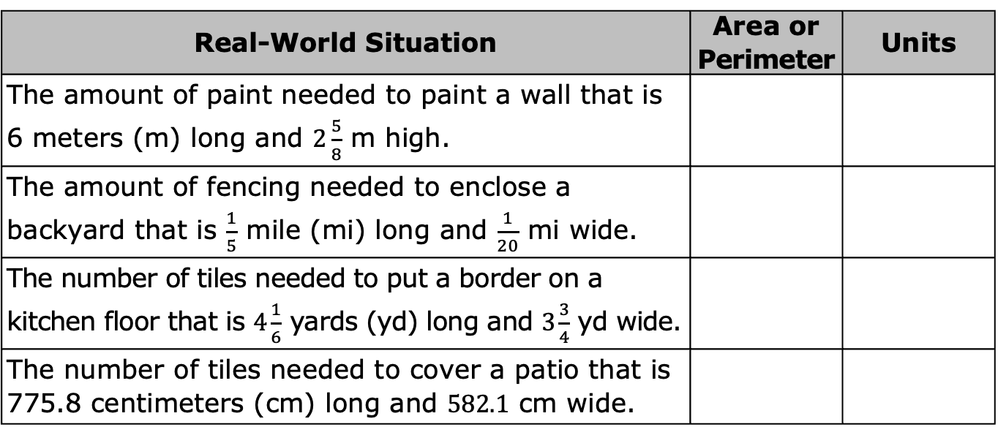
1.6.3 Collaboration: Perimeter and Area with Fractional and Decimal Side Lengths
Work with your partner to complete the table. Choose whether the real-world situation represents area or perimeter, then write the appropriate units for the situation.
Real-World Situation | Area or Perimeter | Units
The amount of paint needed to paint a wall that is 6 meters (m) long and $2\frac{5}{8}$ m high.
The amount of fencing needed to enclose a backyard that is $\frac{1}{5}$ mile (mi) long and $\frac{1}{20}$ mi wide.
The number of tiles needed to put a border on a kitchen floor that is $4\frac{1}{6}$ yards (yd) long and $3\frac{3}{4}$ yd wide.
The number of tiles needed to cover a patio that is 775.8 centimeters (cm) long and $582.1$ cm wide.
volume 1, pg. 36

Slide 23
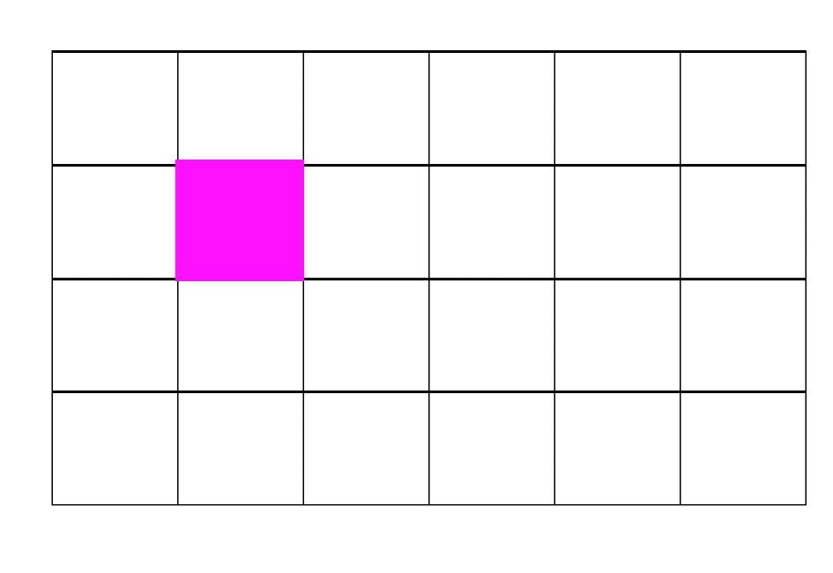
Work with your partner to explain how the square in the grid relates to the units of area being “square units.”
volume 1, pg. 36

Slide 24

Your Turn
volume 1, pg. 36

Slide 25
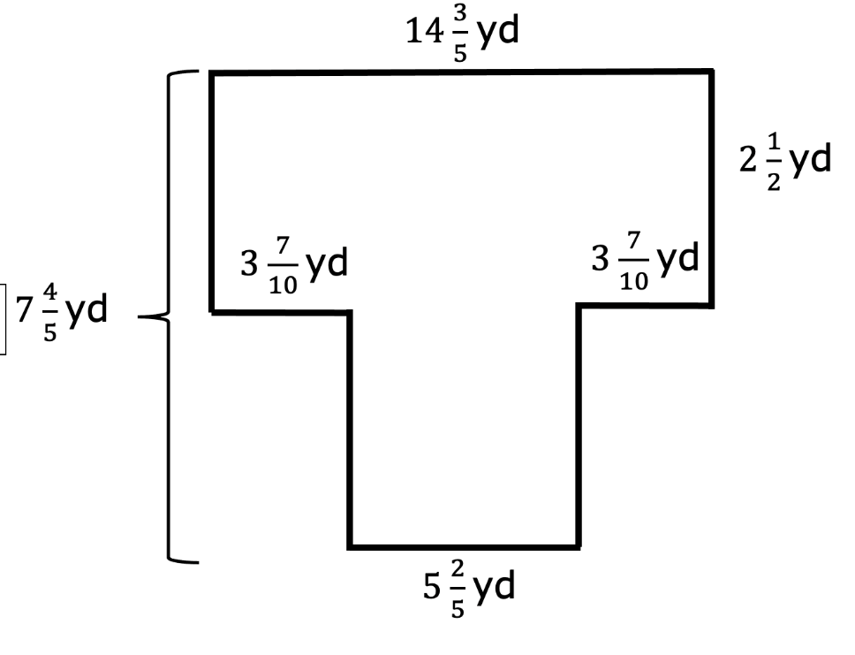
1.6.4 Your Turn!
The giant anteaters’ habitat is shown in the diagram with measurements in yards (yd).
Not to scale
volume 1, pg. 36

Slide 26
The zoo wants to build a walking path around the outside of the enclosure. How long will the walking path be?
Giant anteaters prefer to live in an area covered with grass and trees. How large is the area that needs to be covered with grass and trees?
volume 1, pg. 36

Slide 27

Wrap-Up
volume 1, pg. 37

Slide 28
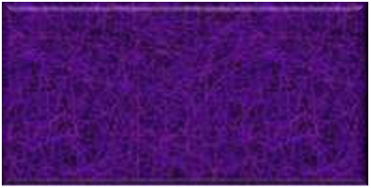
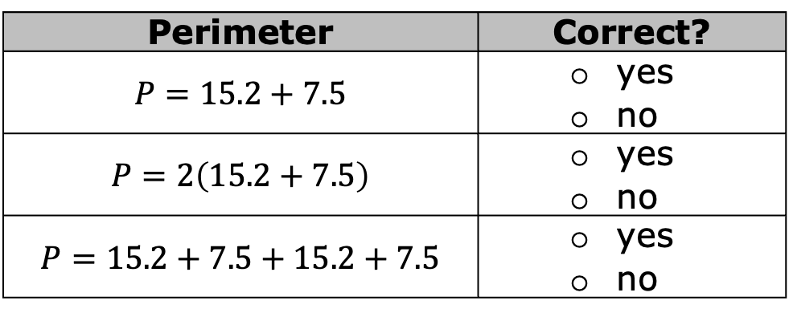


1.6.5 Wrap-Up: Error Analysis
$15.2$ cm
Rodrick was designing a
kitchen. One of the tiles he
wanted to use is shown with
measurements in centimeters
(cm). Rodrick represents the tile’s perimeter in different ways.
Determine which representations are correct.
$7.5$ cm
Perimeter | Correct?
$$P=15.2+7.5$$ | yes no
$$P=2\left(15.2+7.5\right)$$ | yes no
$$P=15.2+7.5+15.2+7.5$$ | yes no
volume 1, pg. 37

Slide 29




Rodrick represents the area of the tile using the diagram shown.
Rodrick made a mistake when labeling the smaller areas. Correct Rodrick’s mistake.
$$7∙15$$
$$7∙0.2$$
$$0.5∙15$$
$$7∙0.5$$
volume 1, pg. 37

